Slide 1
Week 1 Recap

Slide 2
Number systems
1s Complement: (not as common)
“The ones complement representation of a negative number is determined by taking the bitwise complement of the positive integer with the same magnitude. (i.e. flipping all the bits)”
Example: -24 = (00011000)₂ = (11100111)₂
2s Complement:
Another, more common, way to represent negative numbers in binary. Technique: Flip all the bits of the binary representation of the positive integer with the same magnitude, then add 1 (IN BINARY).
Example: -24 = (00011000)₂ = (11100111 + 1)₂ = (11101000)₂
Also works backward: subtract 1, flip all bits, the result is the negative integer.
https://stackoverflow.com/questions/6853524/why-twos-complement
Examples
Decimal: (45)₁₀
Binary: (00101101)₂
Hexadecimal: (2D)₁₀

Slide 3
Character representation
ASCII
A = (01000001)₂ = (65)₁₀ = A (Same grapheme, different font)
2 = (00110010)₂ = (50)₁₀
# = (00100011)₂ = (35)₁₀
https://www.rapidtables.com/code/text/ascii-table.html [2]
UNICODE
© = (11000010:10101001)₂ = 0xC2 0xA9 in UTF-8
= 0x0049 in UTF-16
If you’re interested in the difference between UTF-8 and UTF-16, here’s a decent explanation:
https://www.quora.com/What-is-the-difference-between-UTF-8-and-UTF-16?share=1 [3]
This is only extra knowledge, it’s just handy to know ツ
ASCII: 7-bit encoding
Unicode: 32-bit encoding
BUT WAIT! Isn’t 32 bits a waste of space if your document only uses ASCII characters?? YES
Solution? UTF – Unicode Transformation Format
How does UTF-8 Encoding Work? https://www.johndcook.com/blog/2019/09/09/how-utf-8-works/ [1]

Slide 4
Instructions
Instructions are defined by “Instruction Set Architectures” (ISAs).
Designed in 1978, x86 architecture was one of the first ISAs for microprocessor-based computing.
Programming Code (e.g. C)
↓
Assembler Language (e.g. Assembly Code)
↓
Binary (“Machine Code”)

Slide 5
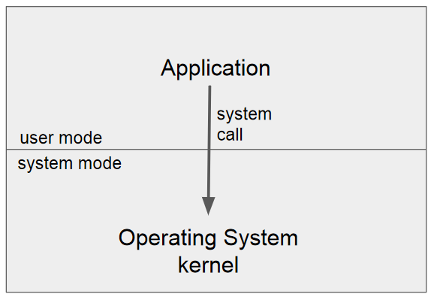
Operating systems
Absolute Path Name:
/home/Dylan/Desktop/uni/document.txt
Relative Path Name:
../Desktop/stuff/uni/document.txt

